Slide 1


PRESENTED BY
Shanmukha Rao Sahukari
Skill Forge – Milestone 1 Presentation
Authentication Module Developed by: Shanmukha Rao Sahukari Tech Stack: HTML, CSS, JavaScript, Node.js, Express.js, MySQL Date: 28 November 2024

Slide 2
TABLE OF CONTENTS
Project Overview
Product Backlog (Sprint 1)
Sprint Backlog Summary
Requirements (Non-Functional)
Architecture Diagram
Use Case Diagram
MYSQL Database Schema
Login Page
Register Page
Landing Page
Postman Testing: Protected Route
Postman Testing: Register API
Postman Testing: Login API
Conclusion

Slide 3

Project Overview
What is SkillForge?
SkillForge is a full-stack e-learning platform designed to provide a seamless learning experience with course browsing, user authentication, dashboards, and future AI-powered features.
Milestone 1 Focus
✔ Authentication Module ✔ Database Setup ✔ UI (Login & Registration) ✔ API Development ✔ Postman Testing ✔ Documentation & GitHub

Slide 4

Product Backlog (Sprint 1)
Key Backlog Items
User Registration Module
User Login Module
Password Encryption (bcrypt)
JWT-based Authentication
Protected Route (/me)
Frontend Login Page
Frontend Register Page
MySQL Database Setup
API Testing (Postman)
Documentation & GitHub Commit

Slide 5

Sprint Backlog Summary
Completed Sprint Tasks
Project folder structure setup
MySQL database & table creation
Register API backend implementation
Login API backend implementation
JWT Middleware creation
Frontend UI design (Login & Register)
Integration of frontend with backend
Postman testing
GitHub repository setup
Requirement & backlog documentation

Slide 6

Requirements (Non-Functional)
Non-Functional Requirements
Security: No plain-text passwords
Performance: APIs must respond quickly
Scalability: Must support future features
Maintainability: Clean folder structure (frontend + backend separation)
Usability: Simple and user-friendly UI design

Slide 7

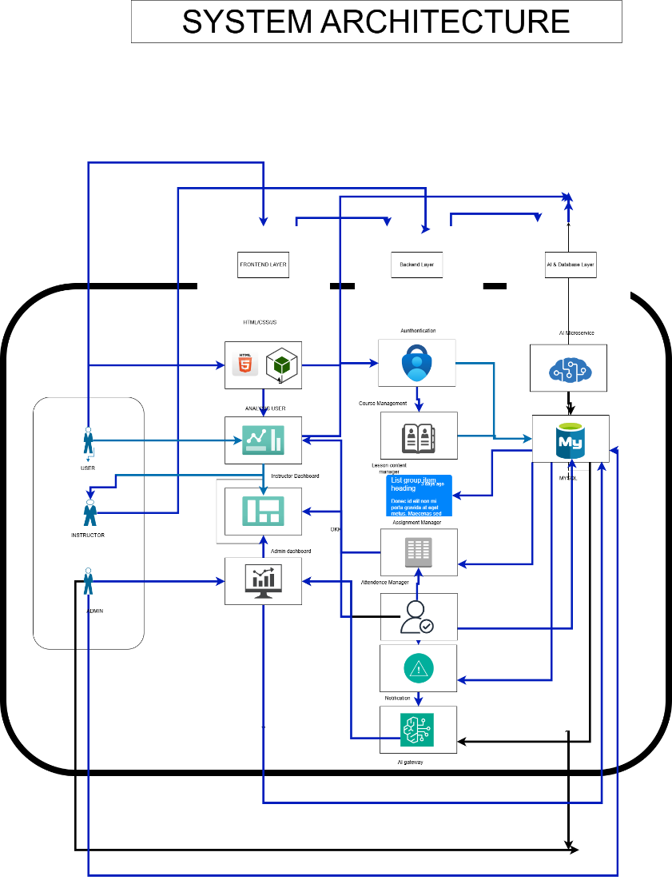
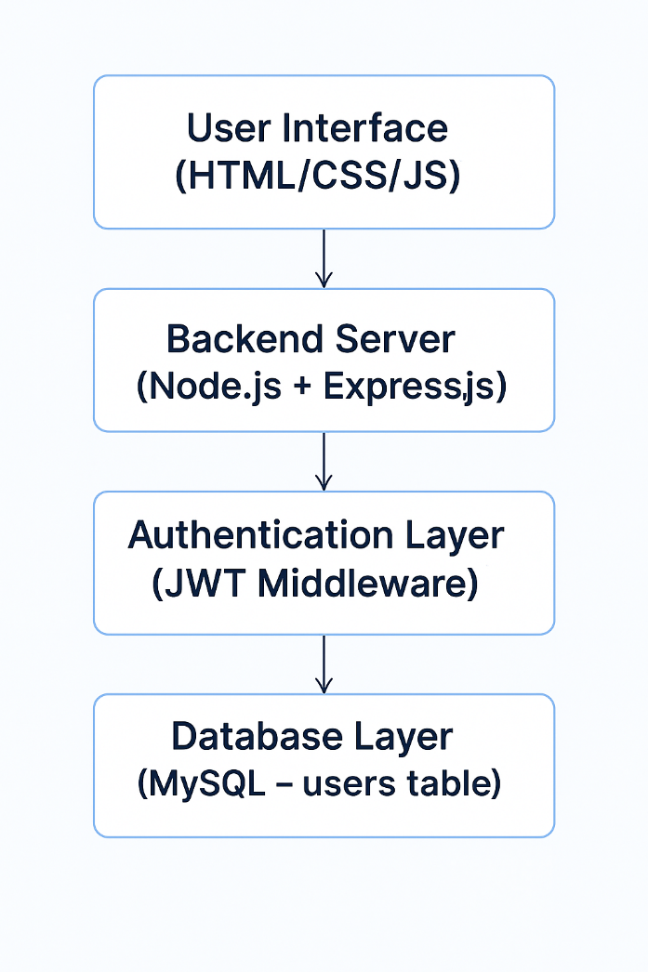
Architecture Diagram

Slide 8
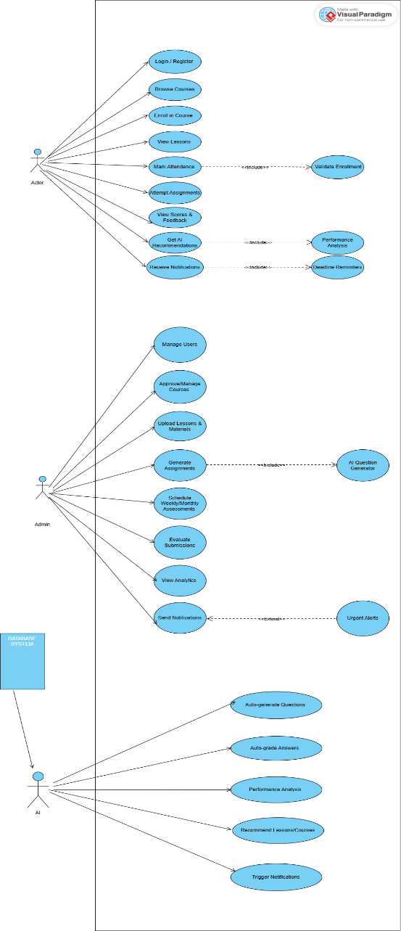
Use Case Diagram
Use Case: Complete structure
Actors:
User
Use Cases:
Register
Login
Access Profile /me

Slide 9

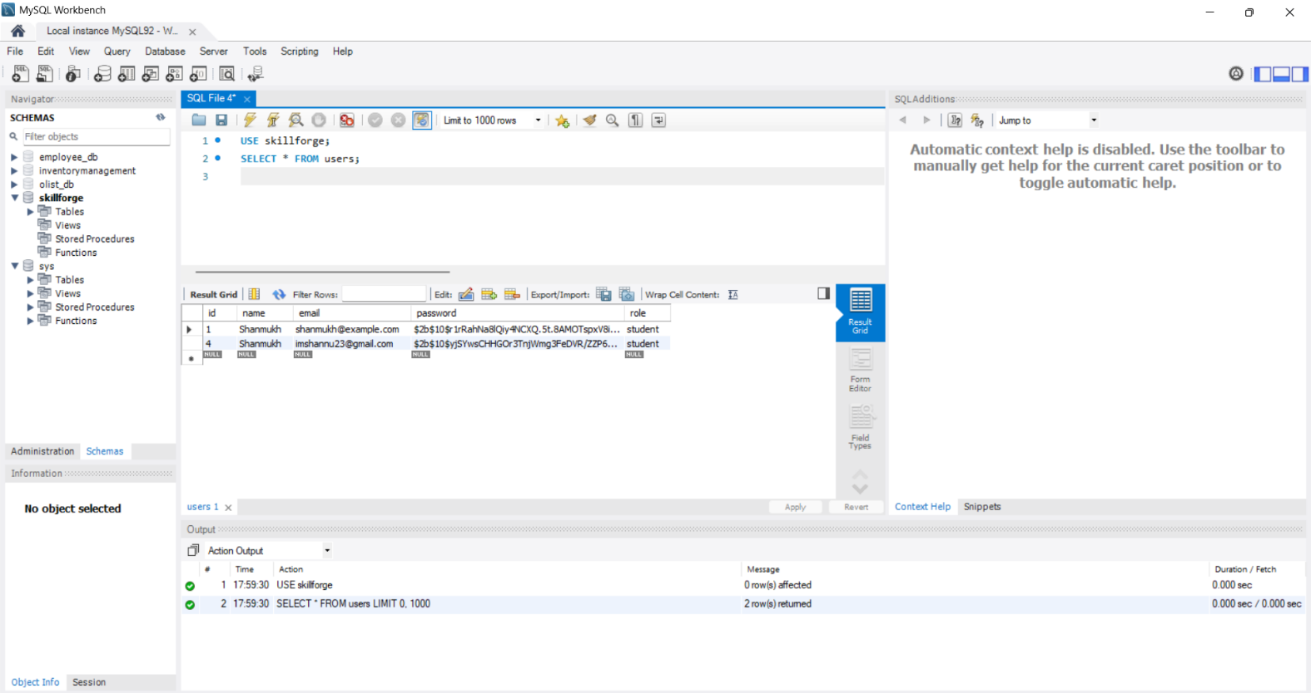
Database Schema
Field | Type | Description
id | INT (PK, Auto Increment) | Unique user ID
name | VARCHAR | Username
email | VARCHAR (Unique) | Login email
password | VARCHAR | Hashed password

Slide 10
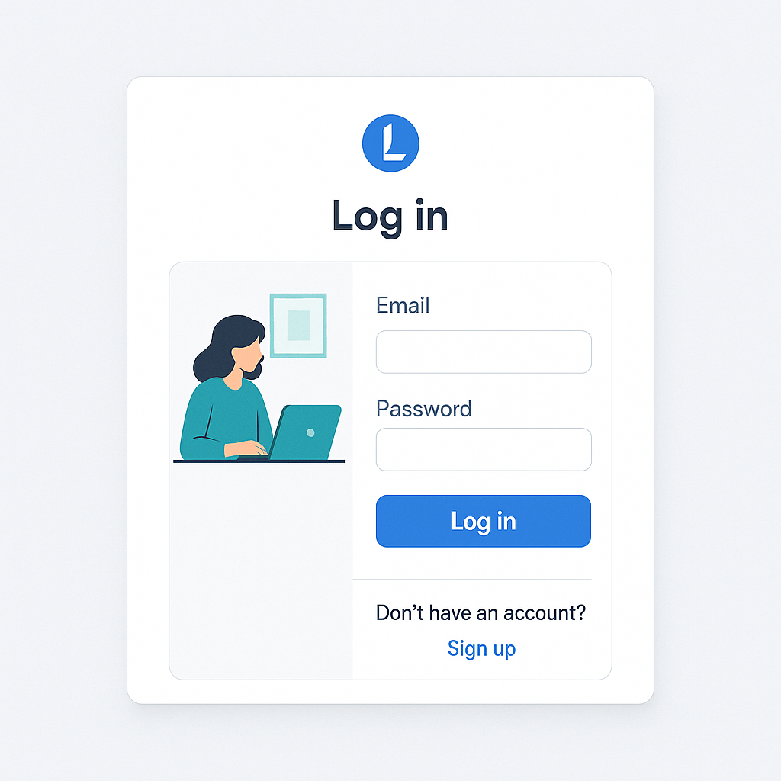
(Login Page)
Login Page Features
Clean user interface
Email and password input fields
Error handling for invalid credentials
Integrated with backend login API

Slide 11
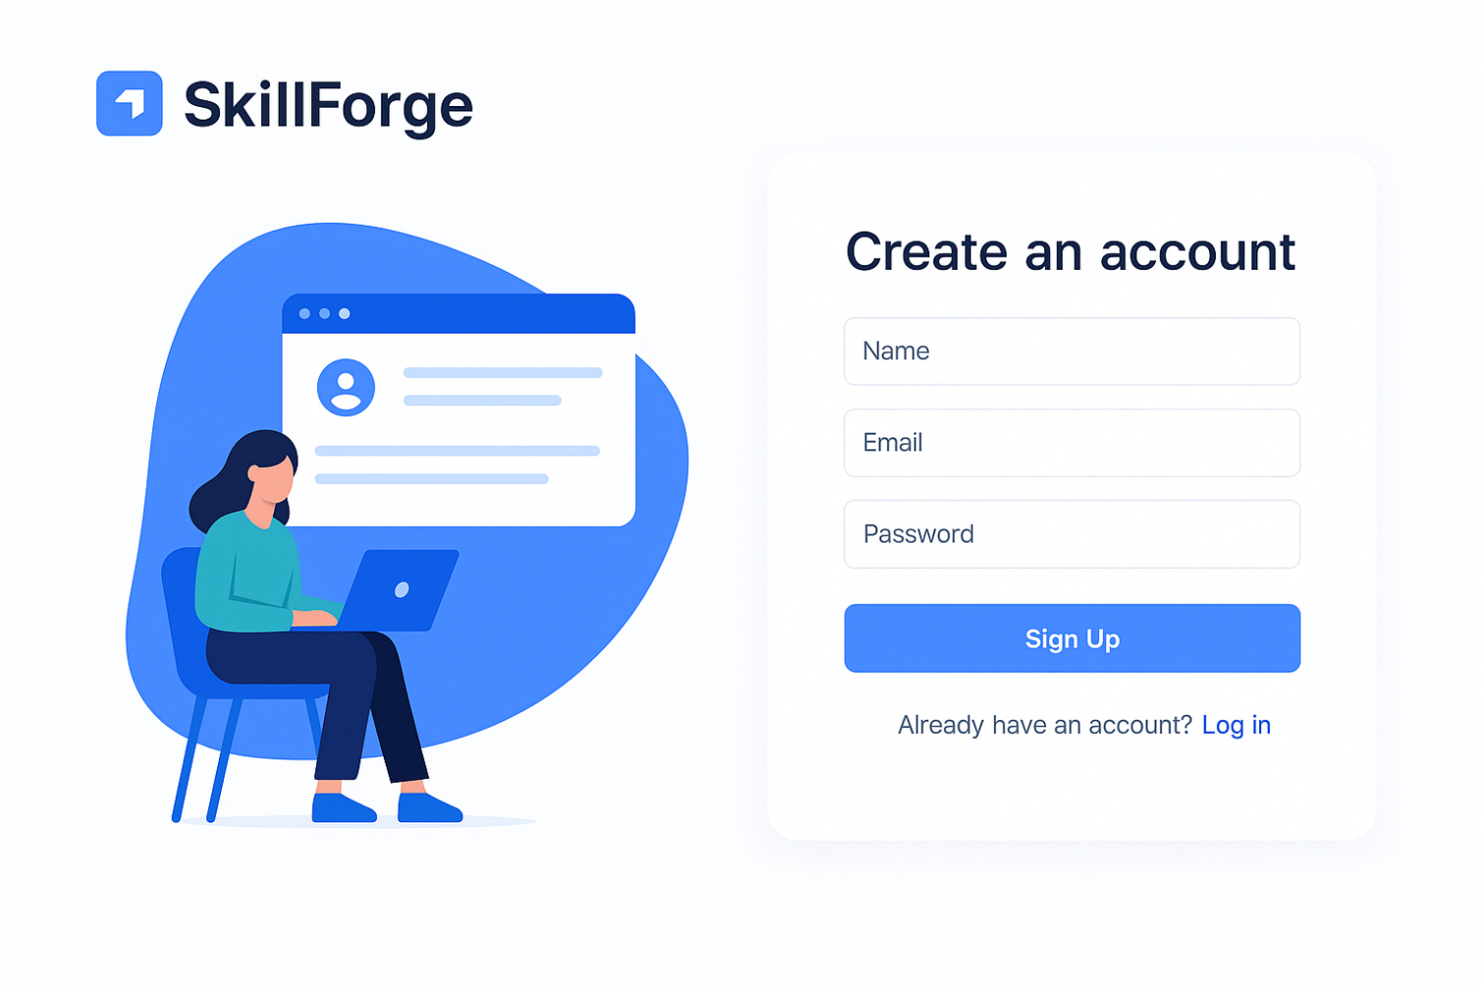
(Register Page)
Register Page Features
Name, email, password fields
Input validation
Connected to backend register API
Auto-redirect after successful signup

Slide 12
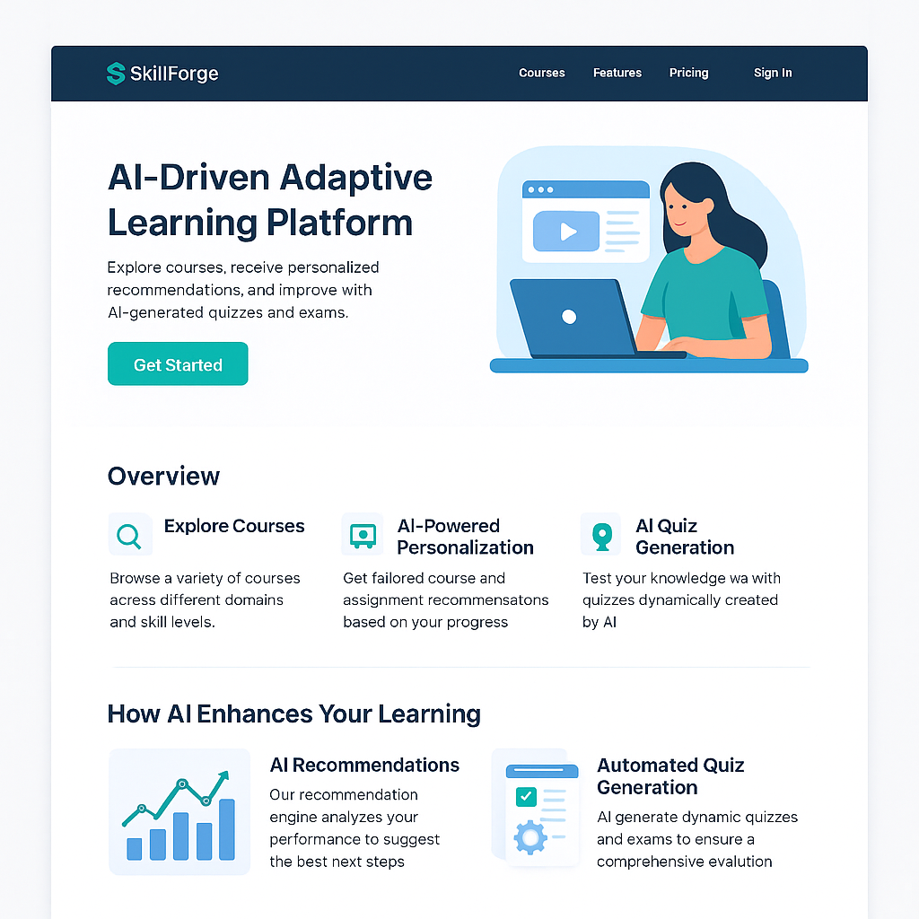
Landing Page
What the Landing Page Represents:
The landing page is the first point of interaction for users on the SkillForge learning platform. It communicates the platform’s purpose, key features, and encourages users to sign up or log in.

Slide 13
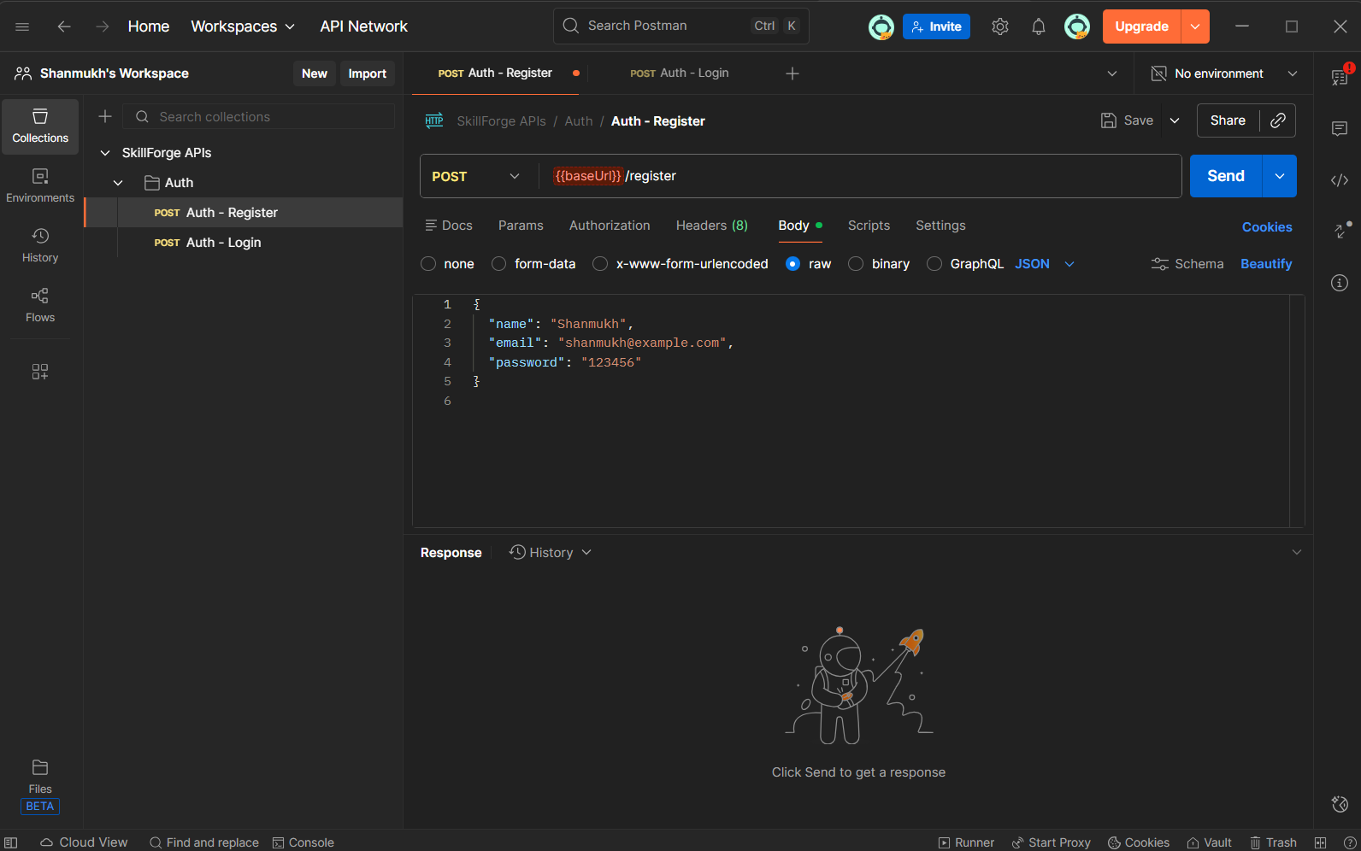
Postman Testing: Register API
Register API Test
Endpoint: POST /register
Purpose: Create new user
Tested with valid and invalid data
Stored in MySQL successfully

Slide 14
Postman Testing: Login API
Login API Test
Endpoint: POST /login
Verifies email & password
Returns JWT token + user info
Error handled: User not found, wrong password

Slide 15
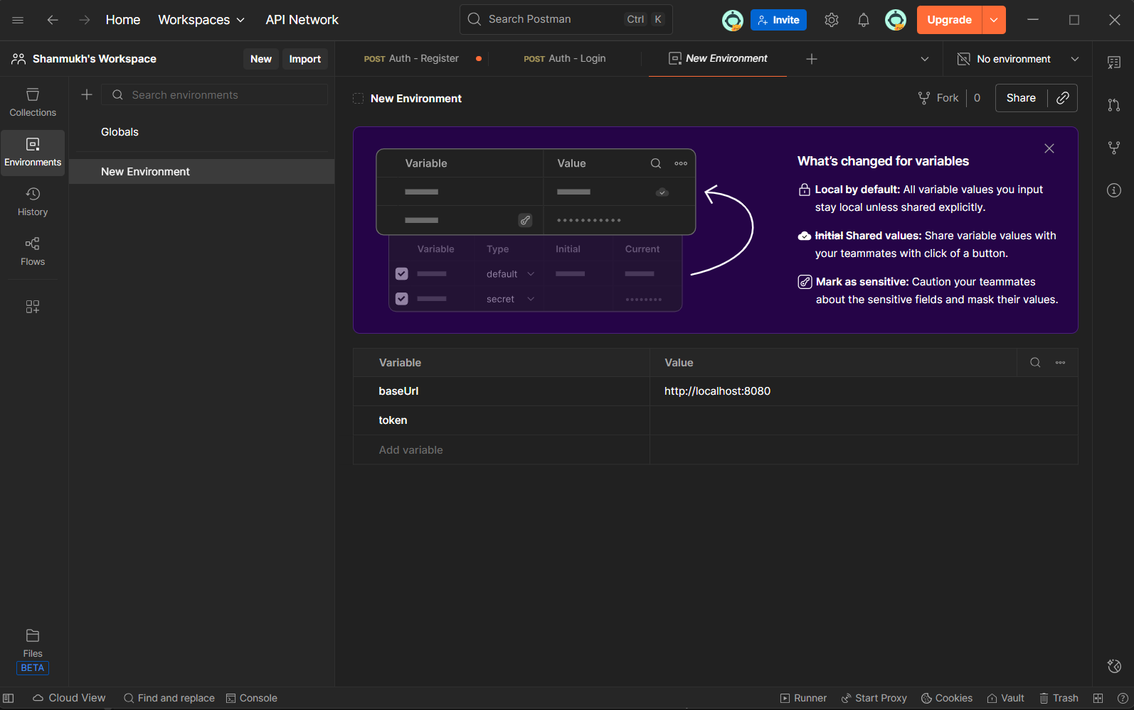
Postman Testing: Protected Route
Protected Route: /me
Requires Authorization: Bearer <token>
Returns authenticated user details
Ensures JWT security

Slide 16

Conclusion
✔ Milestone 1 Completed Successfully
Authentication module fully implemented
Backend tested using Postman
Frontend integrated with backend APIs
Project structured and documented
Ready for Milestone 2 (Dashboard, Courses Module, etc.)

Slide 17

THANK YOU

